Slide 2
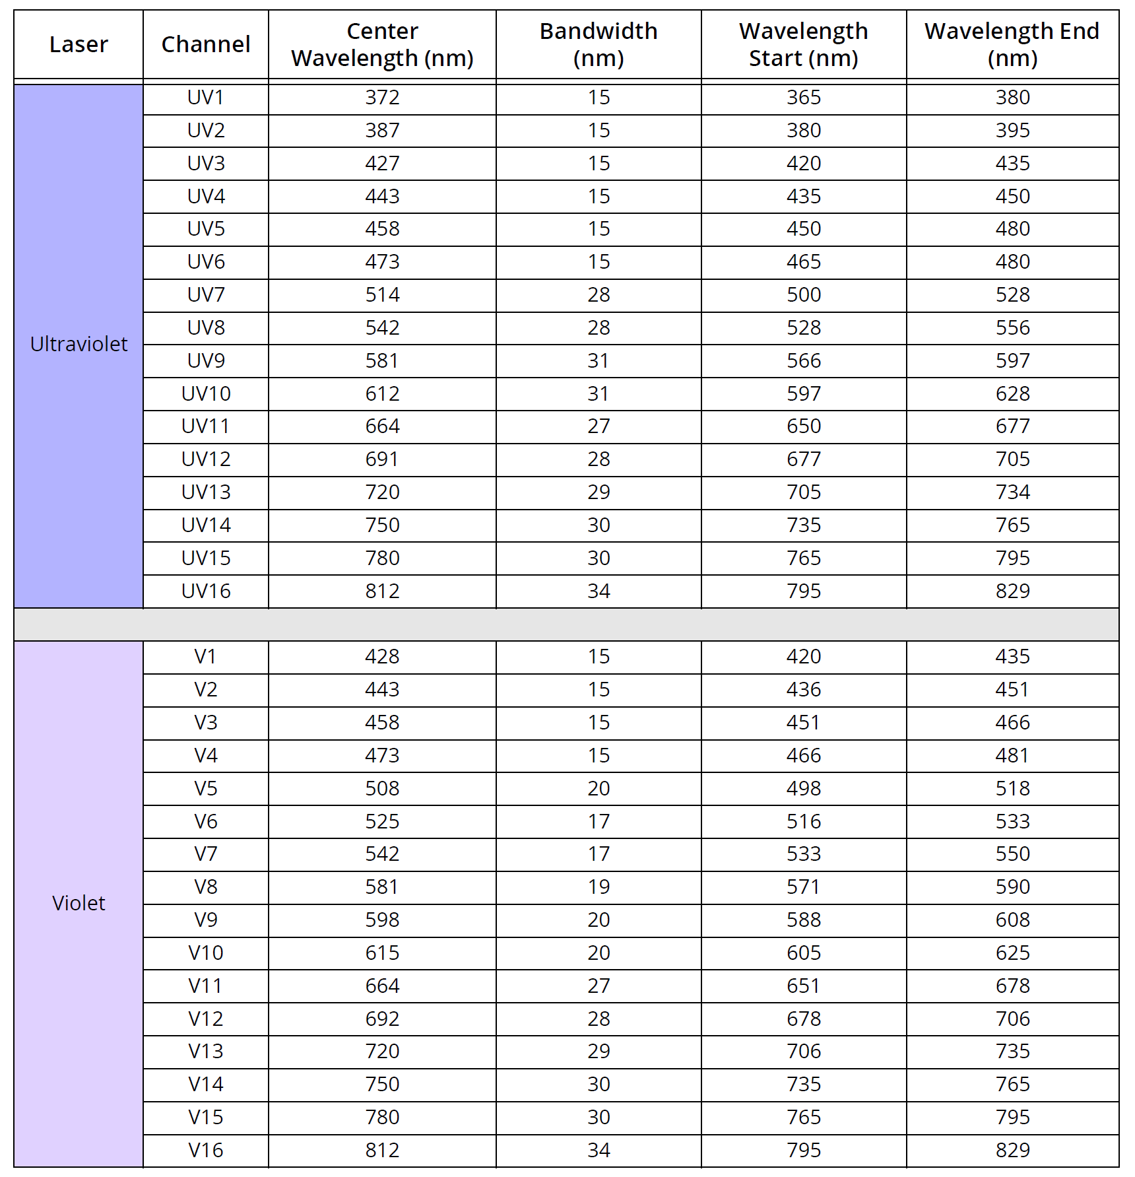
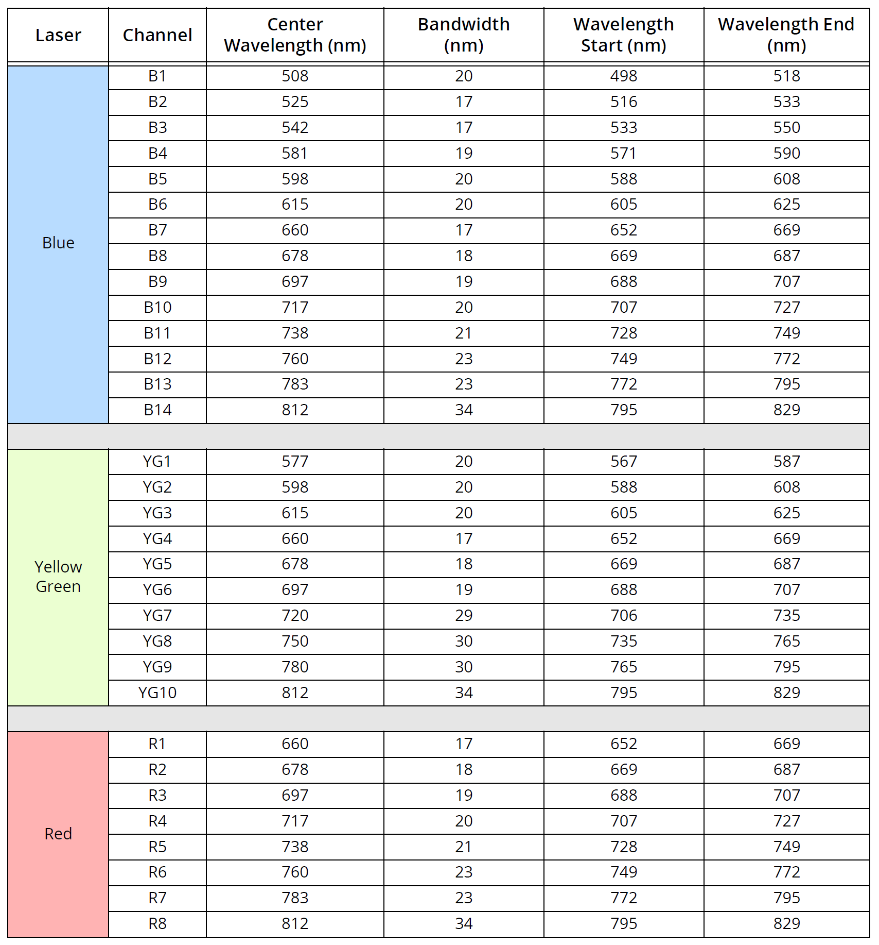
5 Laser Aurora: Detector Arrays
Notes:
5 laser

